Slide 1
Multicopters for Inspection

Slide 2
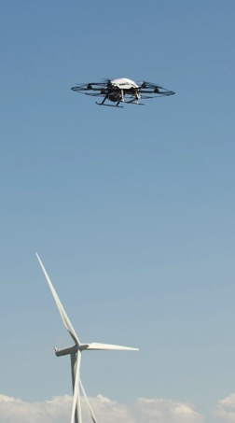
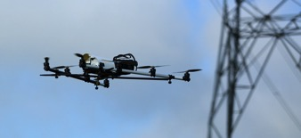
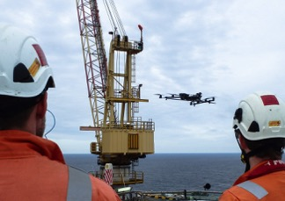
Objectives
To inform potential users of multicopters about their capabilities for performing inspections,
and to advise on the accompanying legal, safety and training requirements.

Slide 3
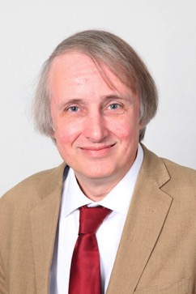
Chair
Colin Brett
Head of Inspection
at
Uniper Technologies Ltd.

Slide 4
Safety
Fire alarm test at 11am

Slide 5
Programme - Morning
Time | Presentation | Speaker
10:30 – 10:40 | Welcome and Introduction | Colin Brett, Uniper Technologies Ltd.
10:40 – 11:05 | Legal, safety and data protection requirements when flying drones | Roy Amos, Panodrone Ltd.
11:05 – 11:30 | ECITB training standards for industrial drone inspections | Adrian Wookey, ECITB
11:30 – 12:00 | Refreshments / Multicopter exhibits
12:00 – 12:25 | Showcase of Use of Multicopters for Inspection – Offshore and Onshore Wind | Hugo Herrmann, EDF Energy R&D UK Centre
12:25 – 12:50 | How drones are being used for inspection in industrial environments | Phil Buchan, Cyberhawk
12:50 – 13:30 | Lunch / Multicopter exhibits

Slide 6
Programme - Afternoon
Time | Presentation | Speaker
13:30 – 13:55 | How to see the bird’s eye view | Mark Murray, Inspectahire Instrument Company Ltd.
13:55 – 14:20 | Validation of UAV inspection quality for the offshore wind industry | Tony Fong, Offshore Renewable Energy Catapult
14:20 – 14:45 | Autonomous drones for next-generation visual inspection | Gareth Pierce, Strathclyde University
14:45 – 15:15 | Refreshments / Multicopter exhibits
15:15 – 16:00 | Panel discussion
16:00 | Close

Slide 7
Panel Discussion
Starts at 15:15

Slide 8
Panel Discussion
Roy Amos, Panodrone Mark Murray, Inspectahire
Adrian Wookey, ECITB Tony Fong, ORE
Hugo Herrmann, EDF Charles McLeod, Strathclyde Uni
Phil Buchan, Cyberhawk

